Slide 1



ABAP on Hana s/4 Hana Training
Day 17
contact@anubhavtrainings.com

Slide 2

Agenda – Day 17
Defining CDS BOPF
Define Business Object
Nodes of Business Object
Building BOPF Scenario
Add Validation ,Determination ,Action
Describing SAP Analytics Cloud ( SAC )
Consume CDS in Analytics Cloud
Creating Dashboard’s on top of CDS in Analytics Cloud

Slide 3

CDS BOPF
The Business Object Processing Framework is an ABAP OO-based framework that provides a set of generic services and functionalities to speed up, standardize, and modularize your development. BOPF manages the entire life cycle of your business objects and covers all aspects of your business application development. Instead of expending effort for developing an application infrastructure, the developer can focus on the individual business logic. Using BOPF, you get the whole application infrastructure and integration of various components for free. This allows you to rapidly build applications on a stable and customer-proved infrastructure.

Slide 4
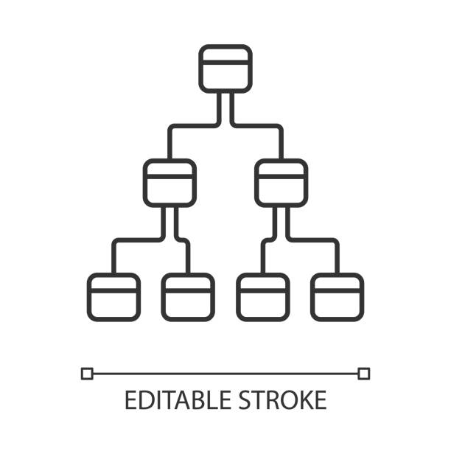
Flow of CDS Views in Hierarchy
The business objects are the basic units of the BOPF-based programming model. Business applications or processes operate on certain business objects.
A business object is represented as a hierarchical tree of nodes. A single node includes a set of semantically related business object data and the corresponding business logic.
On the technical level, each node is implemented with a regular Dictionary table, where each node instance corresponds to a single table entry (table rows).
Nodes, attributes, and alternative keys set up the data part of a business object. Again from a technical viewpoint, attributes form the columns of the table. A node serves as an anchor point for connecting the business logic of the business object.
For each node, several types of entities can be defined to form the specific business logic part of a business object.

Slide 5
Node of Business Object
Node Entity ...is used...
Action
... to implement a service (operation or behavior) of a business object. An action is explicitly triggered by a service consumer, such as the user interface.
Determination
... to provide functions that are automatically executed as soon as certain trigger conditions are fulfilled. A determination is triggered internally due to changes made to the instance of a business object.
Validation
... to either validate whether a specific action can be executed on a specific node instance (action validations) or whether a set of node instances is consistent (consistency validations).
Query
... to search for business object instances that meet certain search criteria.
Authorization Check
... to provide an authorization concept for BO nodes (for their data and for the operations on their data).
Association
... to connect business object instances that are located on different nodes.

Slide 6
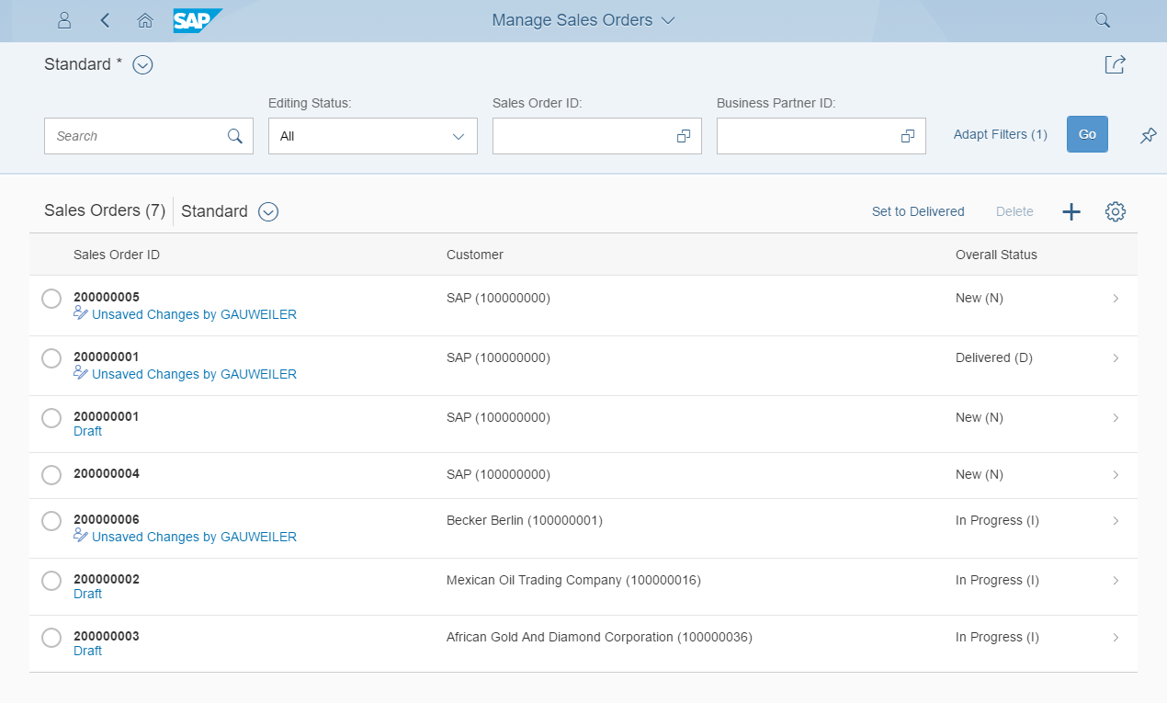
Development flow & Artifacts
BOPF (Business Object Processing Framework) is a framework for working with the BO (Business Objects). BO is a representation of a type of uniquely identifiable business entities described by a structural model, an internal process model, and one or more service interfaces.
consume
SAP Fiori Elements, …
OData Service
Consumption view
ption view
Search Object(s)
Core Data Services
generate / publish
Subnode consumption view
Subnode consumption view
Subnode consumption view
Subnode consumption view
Metadata Extension
enrich
Data Definition
BOPF Business Object
generate
implement
Custom ABAP Business Logic
CDS metadata extensions can currently only be created for CDS views. A CDS metadata extension is a CDS object that is defined and transported in a separate CDS source code.
Draft table
Database table
Draft table
Draft table

Slide 7
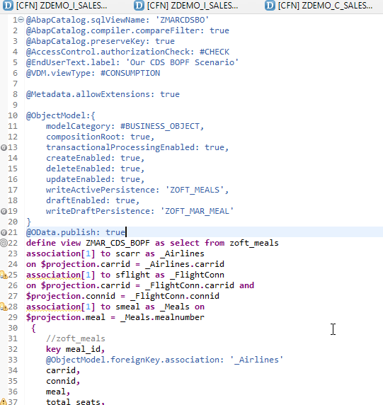
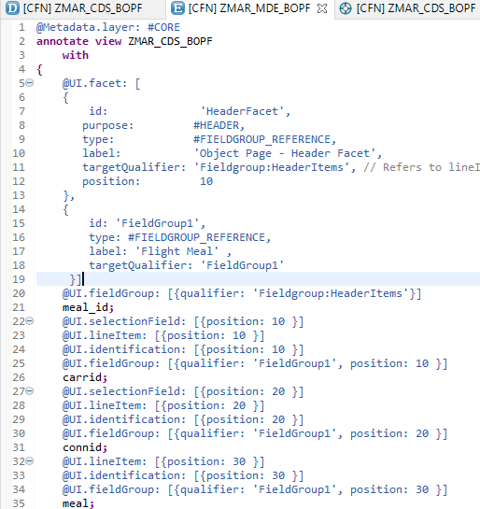
Transactional UX App with CDS & BOPF
Exercise:-
CDS BOPF Scenario
Annotate BO

Slide 8
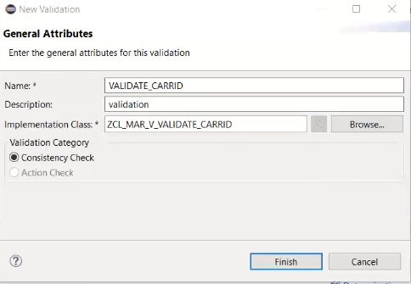
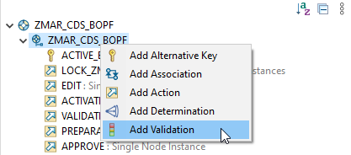
Validation
If this condition is fulfilled, the BOPF runtime automatically executes the validation. We call this implicit validation. Implicit validations are executed after each modification of node data, depending on the configured request nodes. A validation is an entity of a business object node that is triggered in certain situations to check various aspects of a given set of node instances. It is used used to validate whether a set of node instances is consistent.
Right Click on Business Object and Add Validation
Exercise
Implementing Validation

Slide 9
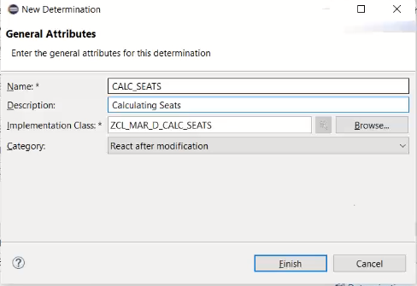
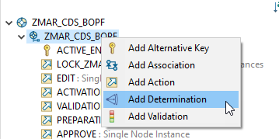
Determination
The Determination, change of business objects, such as saving, is the logic that moves when certain conditions are met.
Right Click on Business Object and Add Determination
Exercise
Implementing Determination

Slide 10
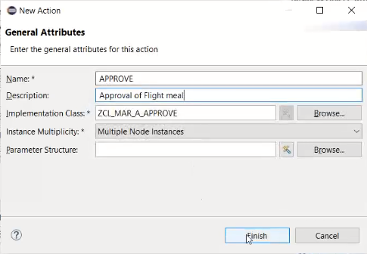
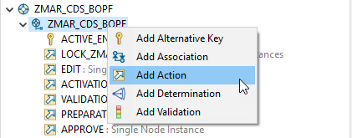
Action
Are the operations which are non-standard for a business object. Using these actions, we can also perform the CRUD with the help of BO.
The BOPF framework assigns the new action to the business object node and creates an action class that implements the BOPF action interface /BOBF/IF_FRW_ACTION .
Right Click on Business Object and Add Action
Exercise
Implementing Action Code

Slide 11
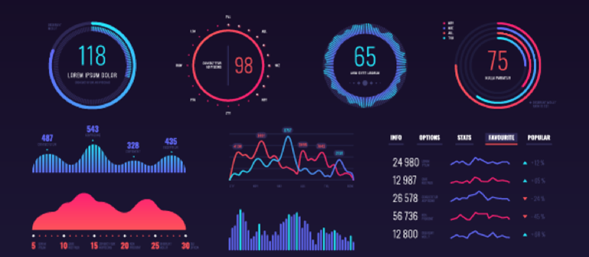
SAP Analytics Cloud ( SAC )
The SAP Analytics Cloud solution combines BI, augmented and predictive analytics, and planning capabilities into one cloud environment. As the analytics layer of SAP's Business Technology Platform, it supports advanced analytics enterprise-wide.
SAP Analytics cloud is a SaaS offering by SAP for complete BI, Planning, Predictive and designer capabilities.

Slide 12
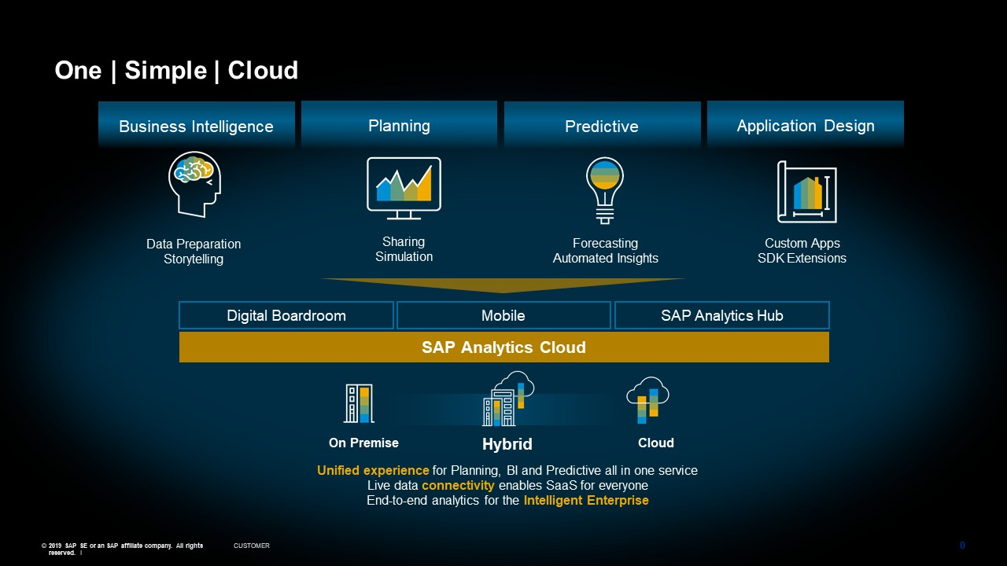
Phases of SAP Analytics Cloud ( SAC )

Slide 13
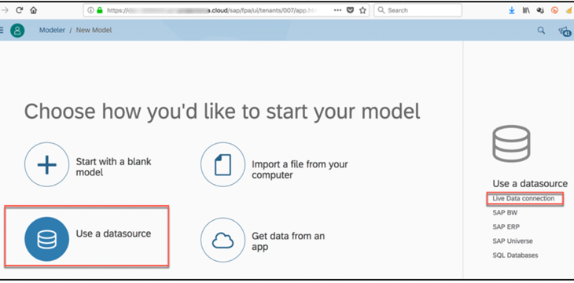

Consume CDS in Analytic Cloud
With Live Data
Connection

Slide 14

Exercise
Consume CDS in Analytics Cloud Code

Slide 15
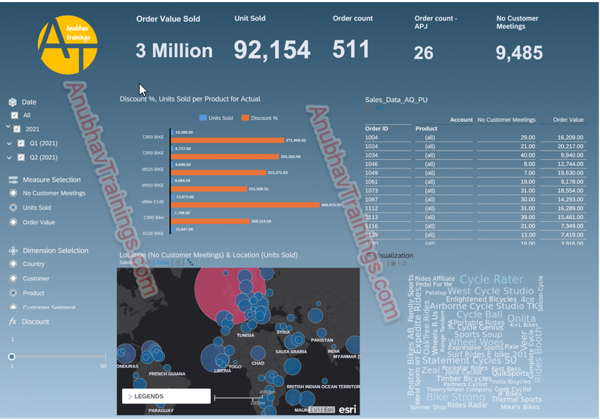
SAC Dashboard on top of CDS

Slide 16

End of Day 17
Trainer: Anubhav Oberoy

Slide 17

Trainer: Anubhav Oberoy

Slide 18
THANK YOU
If you cannot do
great things, do small things in a great way.
Anubhav Oberoy
https://www.anubhavtrainings.com

Slide 19


We’re committed to empower you to be
Most Desirable Resource
through powerful training solutions.
We build the workforce of the future.
250+
Corporate Clients
30,000+
Learners Trained
25000+
Learners Placed
FREE WEBINARS
Sign up for free webinars with industry experts every fortnight!
Enroll Now!
Contact us today!
https://anubhavtrainings.com/

Slide 20




More from AnubhavTrainings.com

